Slide 1
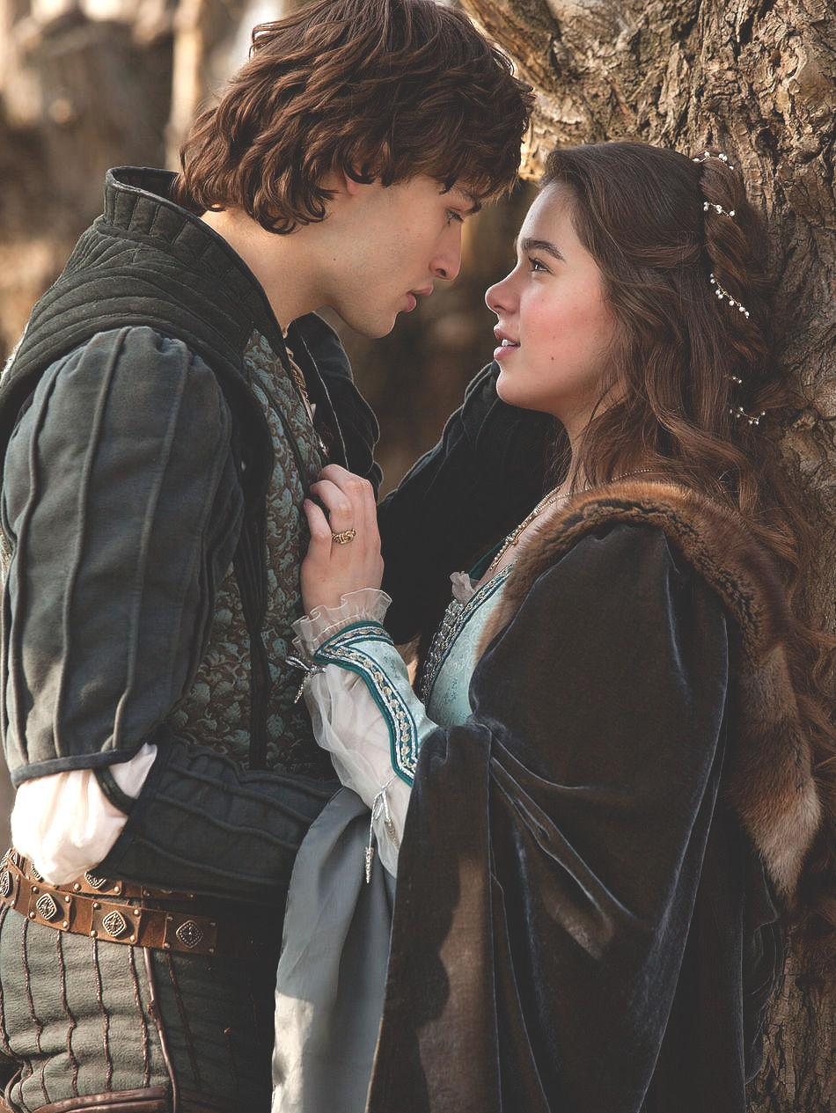
ROMEO & JULIET
By William Shakespeare
Paula Osorio, Merhea Domingo 3C
Susana Yu 3A

Slide 2
INDEX
William Shakespeare……………………….Pg 3
Important characters……………………….Pg 4/Pg 5
Important scenes…………………………….Pg 6/Pg 7/Pg 8

Slide 3
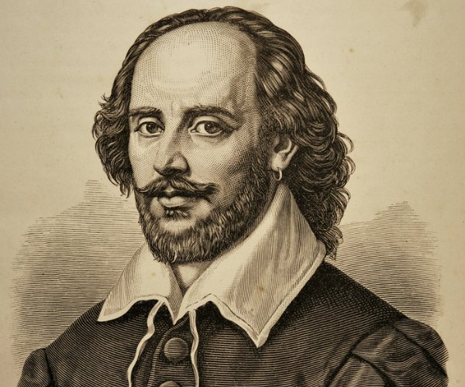
WILLIAM SHAKESPEARE
Born on April 26th, 1564, in Stratford-upon-Avon, England.
Died on April 23rd, 1616, in Stratford-upon-Avon, England
Poet and playwright.
June 29th, a cannon set fire to the thatch of the Globe and burned the theatre to the ground. So, they rebuilt “The Globe” theatre.
Boys dressed like women.
Famous because of his tragedies.

Slide 4
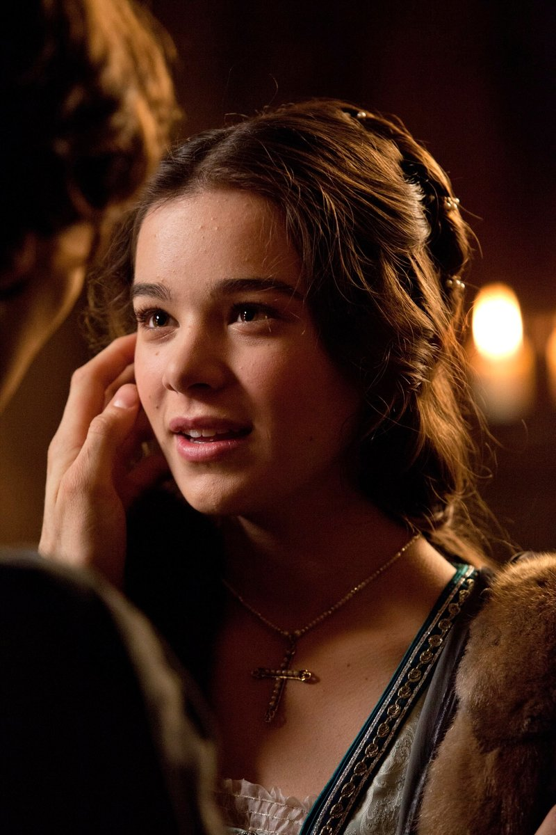
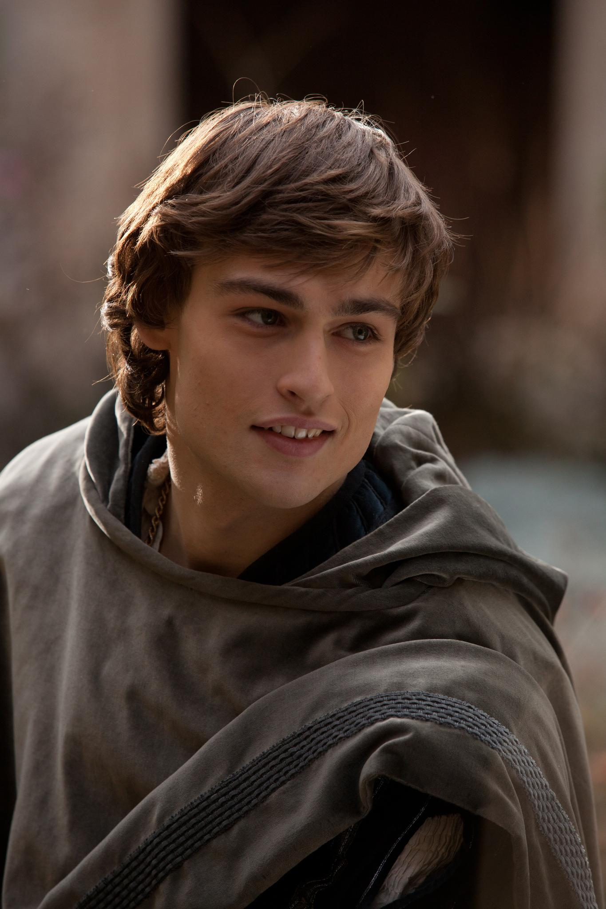
IMPORTANT CHARACTERS
Juliet Capulet
Romeo Montague

Slide 5
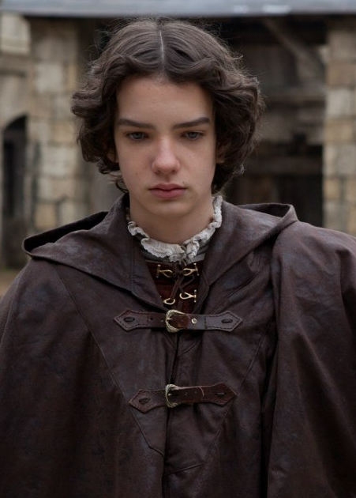
IMPORTANT CHARACTERS
Tybalt Capulet
Benvolio Montague

Slide 6
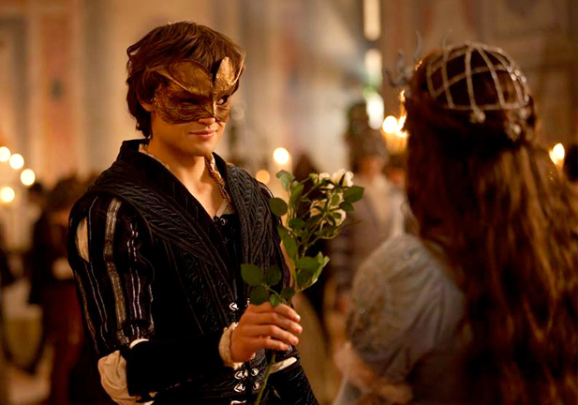
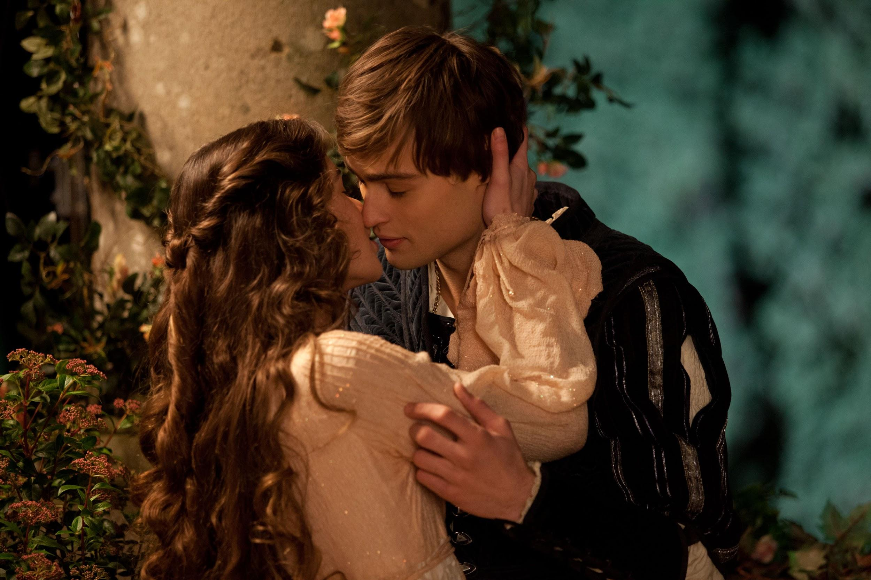
IMPORTANT SCENES
The dance
The balcony

Slide 7
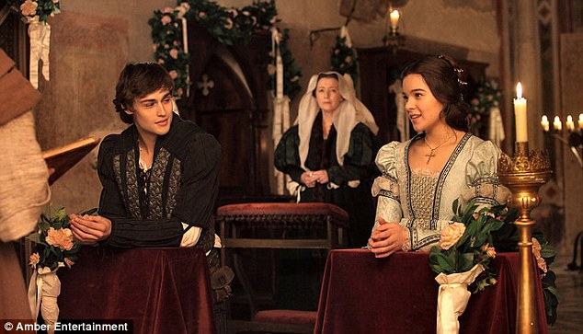
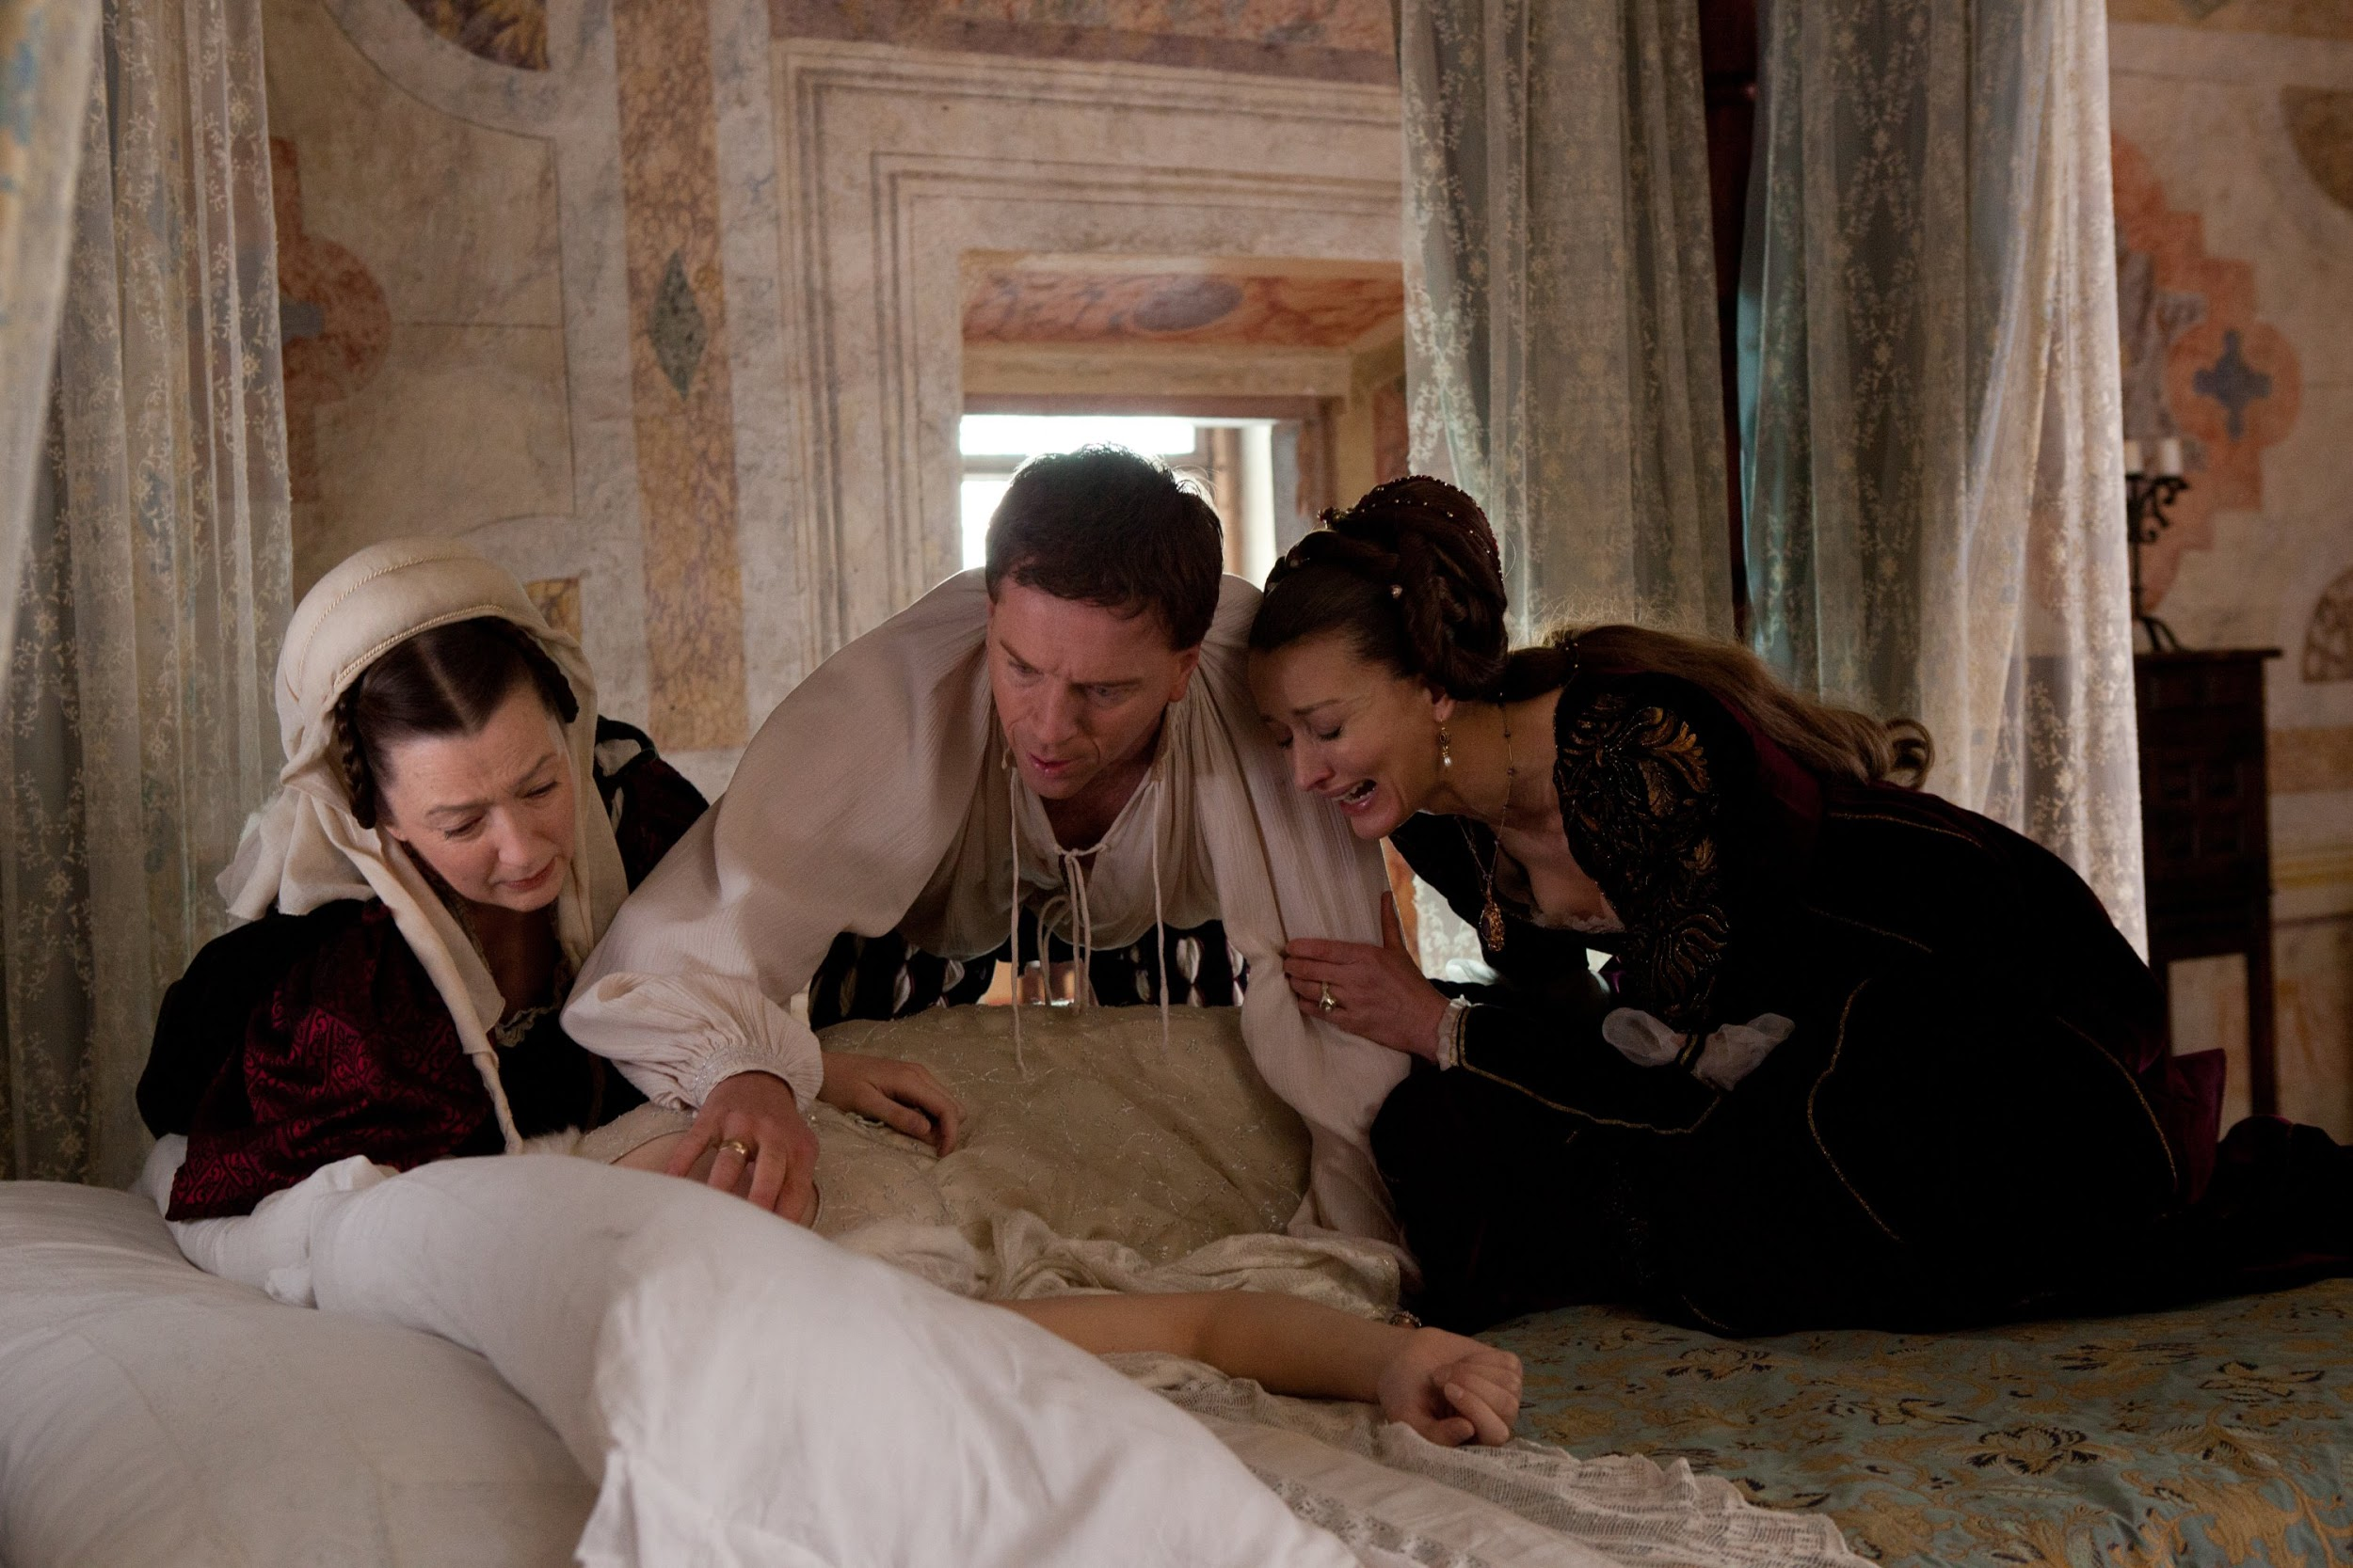
IMPORTANT SCENES
The secret wedding
The lie

Slide 8
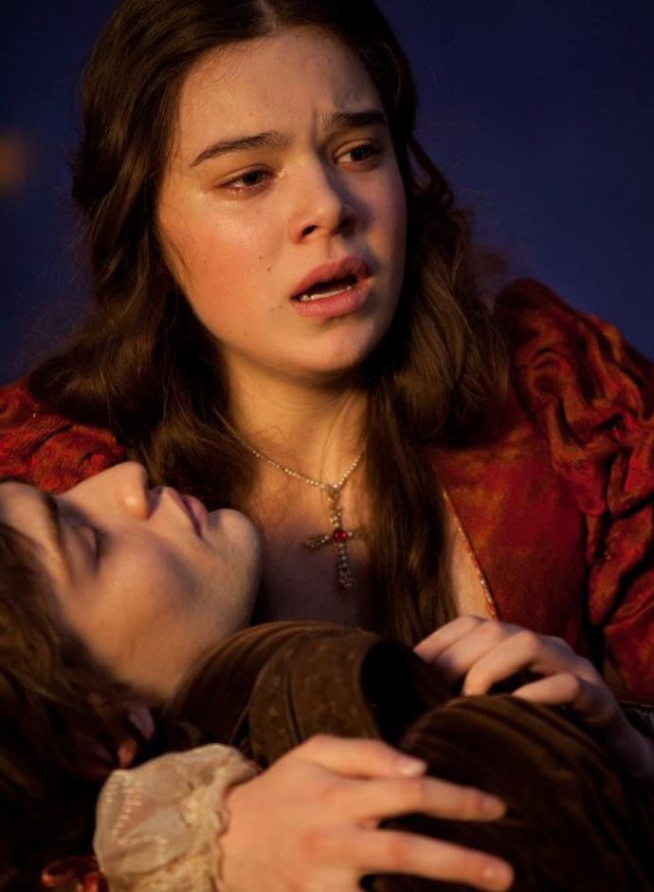
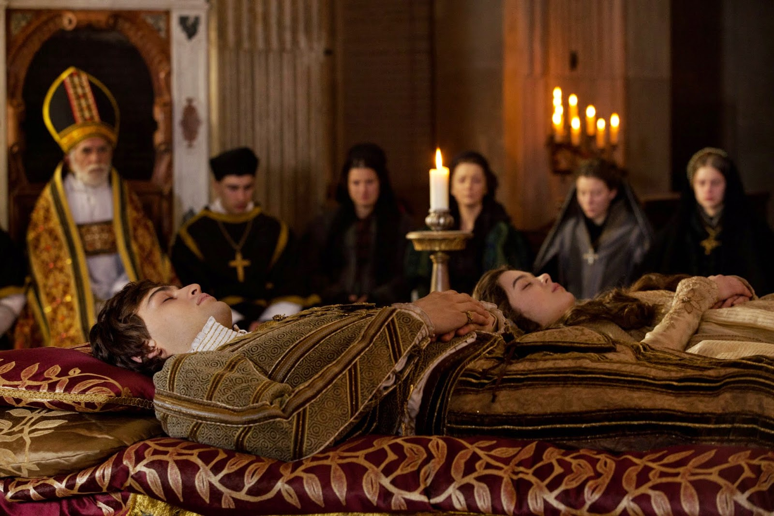
IMPORTANT SCENES
The wrongful death
Bittersweet ending

Slide 9
THANKS FOR YOUR ATTENTION!

